Slide 1
Software Engineering
LECTURE 1: Introduction

Slide 2
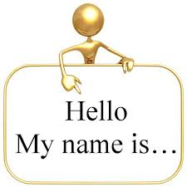
Introducing

Slide 3

Introducing

Slide 4
Class Goals
Introduce Myself & (with)Yourself
Learn about Professional Software Development
Concern to Software Engineering Ethics

Slide 5

Introducing

Slide 6











Introducing Myself- Academic Biography
Education
Organizations where I have worked?

Slide 7
Introducing Myself- Academic Biography
Research Interests
  Human-Computer Interaction (HCI)
  Health Informatics
  Humanitarian Technology
  Computer Semiotics.
  Usability & User Experience (UX)
  Military Information Systems
Publication & Citation Summary
  Total publications: 80+
Research Grant
  Approximate 150 000 Euro

Slide 8
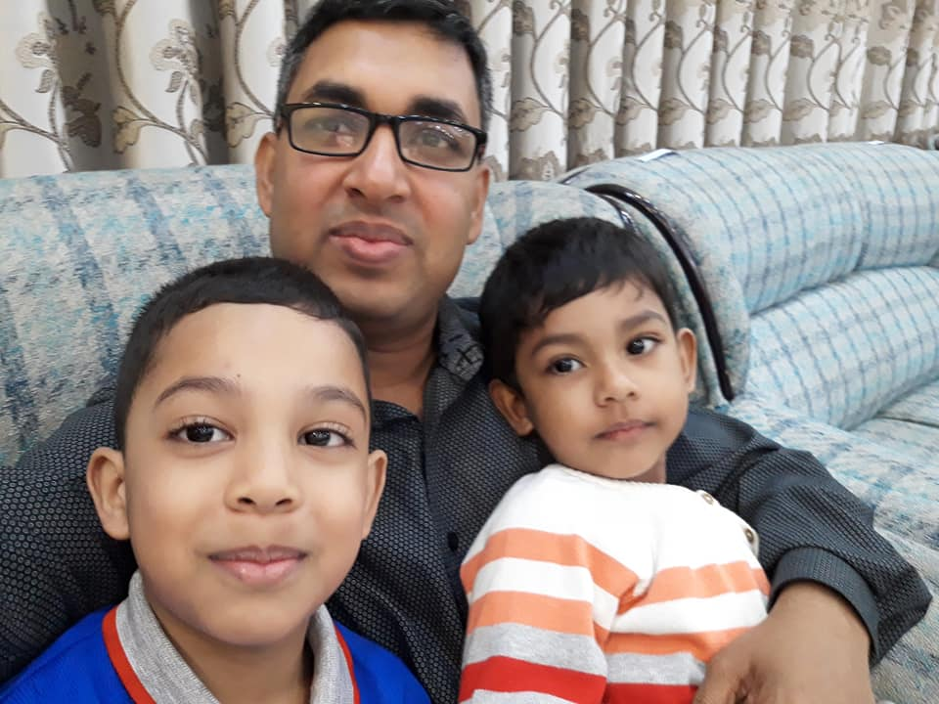
Personal Biography

Slide 9
Course Information
Course Name: Software Engineering
Credit: 3
Lecture Day & Time:
Textbooks :
    Software Engineering- a practitioner’s Approach BY Roger S. Pressman
    Software Engineering BY Ian Sommerville
Other Reading Materials: Research articles and (other) book chapter
Day | Sec A (Time) | Sec B (Time)
Monday |  | 0800 – 0855, 0900 - 0955
Tuesday |  | 1000 - 1055
Wednesday | 1145 - 1240
Thursday | 1245 – 1340, 1345 – 1440

Slide 10
What the class will look like
Lectures
Readings (articles and book chapters)
Class Tests, Midterm Exam, Final Exam
Term Paper/ Presentations/ seminars
Practical case study
Lecture Sessions will be Interactive !
Device-free – for your own sake!

Slide 11
Communication
Everything of this course will be handled by
Facebook !
  A closed and secret group will be created soon.
  All kind of course material will be delivered.
  Any kind of instruction, notice, CT results will be published.
  Any query related to this course will be placed there!
For any personal issue:
  E-mail to: nazrulturku@gmail.com ; anis972@gmail.com
  Mobile: 01725560099; 01769023936
  Visit our rooms at 8th Floor

Slide 12
Quotation
To the , the glass is half full.
To the , the glass is half empty.
To the , the glass is twice as big as it needs to be.
Optimist
Pessimist
Engineer

Slide 13
Course Objective
You will gain a broad understanding of the discipline of software engineering and its application to the development of and management of software systems.
This includes:
knowledge of basic SW engineering methods and practices, and their appropriate application;
A general understanding of software process models such as the waterfall and evolutionary models.
An understanding of software requirements and the SRS document.
An understanding of different software architectural styles.

Slide 14
Course Objective
This includes (Continuing…)
An understanding of approaches to verification and validation including static analysis, and reviews.
An understanding of software testing approaches such as unit testing and integration testing.
An understanding on quality control and how to ensure good quality software.
An understanding of some ethical and professional issues that are important for software engineers.

Slide 15
Course Outline (Beta)
Introduction to software engineering (Lt Col Nazrul / Lt Cdr Anis)
Software processes (Lt Col Nazrul)
Agile software development (Lt Col Nazrul)
Requirements engineering (Lt Col Nazrul)
System modeling (Lt Cdr Anis)
Performing user interface design (Lt Cdr Anis)

Slide 16
Course Outline (Beta)
Architectural design (Lt Cdr Anis)
Design and implementation (Lt Cdr Anis)
Product metrics (Lt Col Nazrul)
Software testing and maintenance (Lt Col Nazrul)
Dependability and Security (Lt Cdr Anis)
Security engineering (Lt Cdr Anis)
Project planning and management (Lt Cdr Anis)

Slide 17
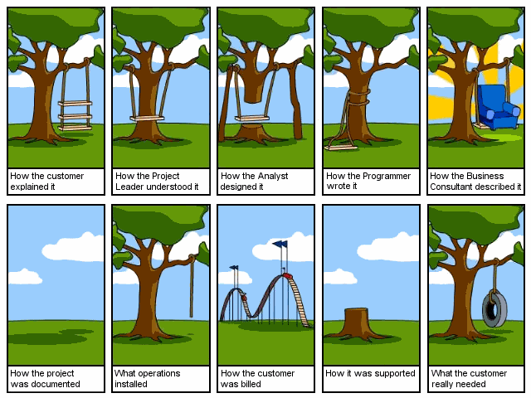
SW Engineering!

Slide 18
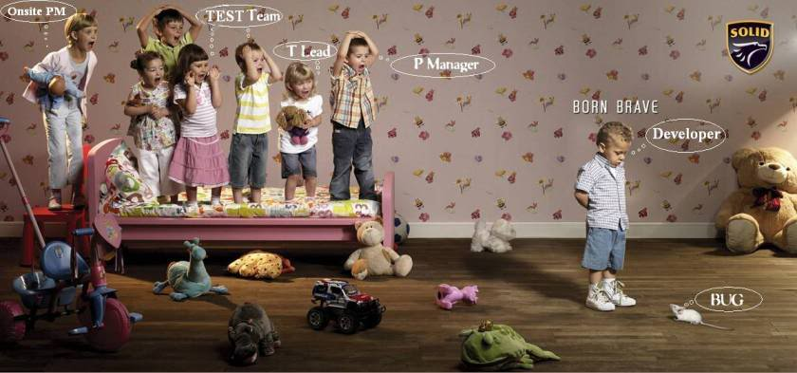
SW Engineering!

